Slide 1
Objects & Final Project
Week 8
ReDI

Slide 2

Agenda
Hand-in 2
Recap
Arrays
Loops
Objects
Introduction to Final Project

Slide 3
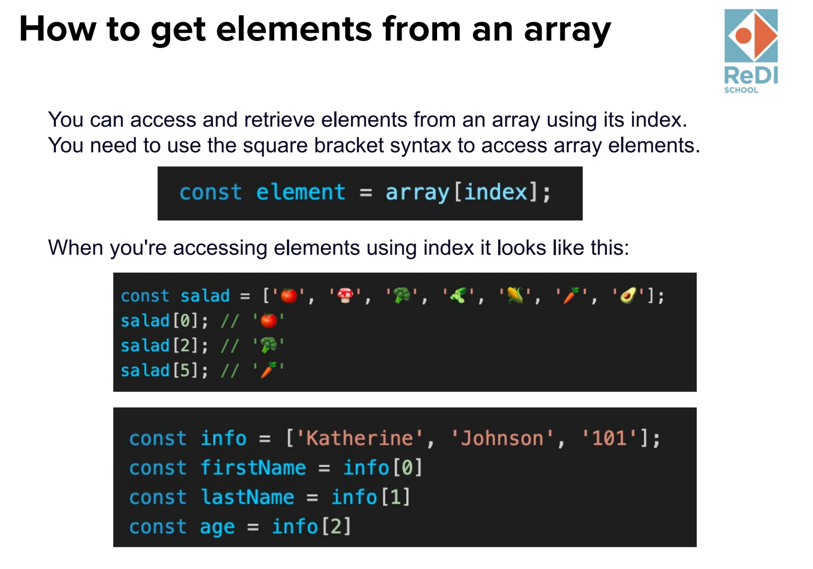
Recap

Slide 4
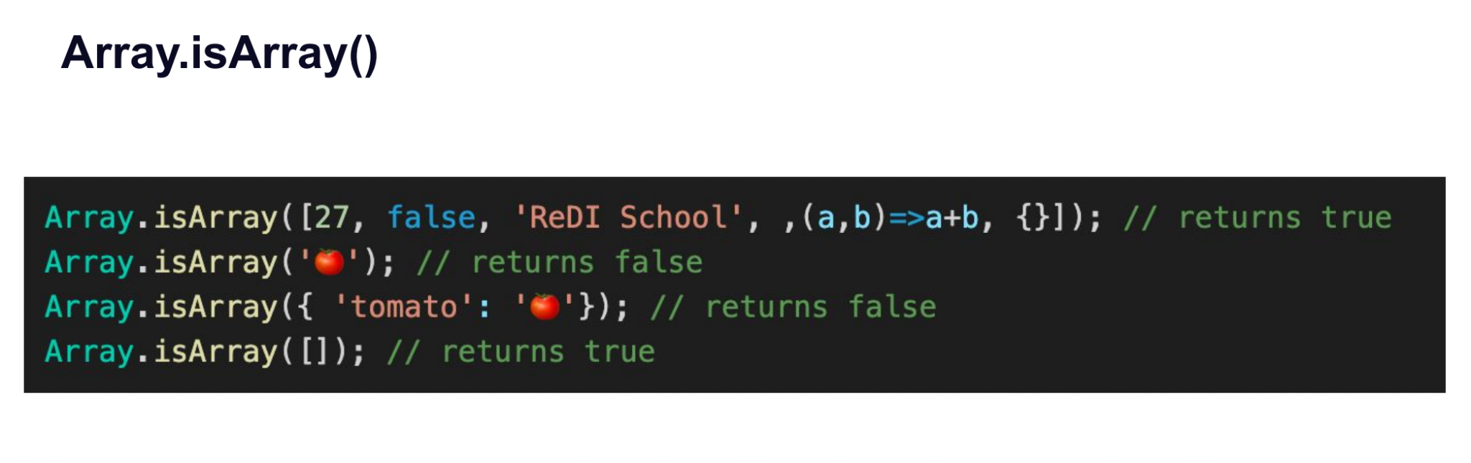
Recap

Slide 5
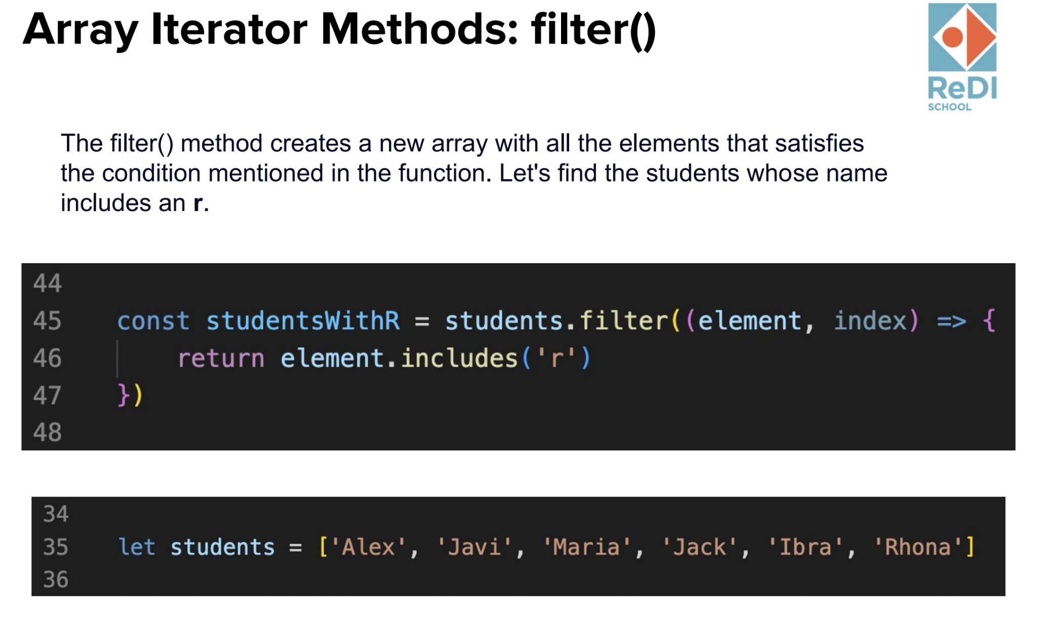
Recap

Slide 6
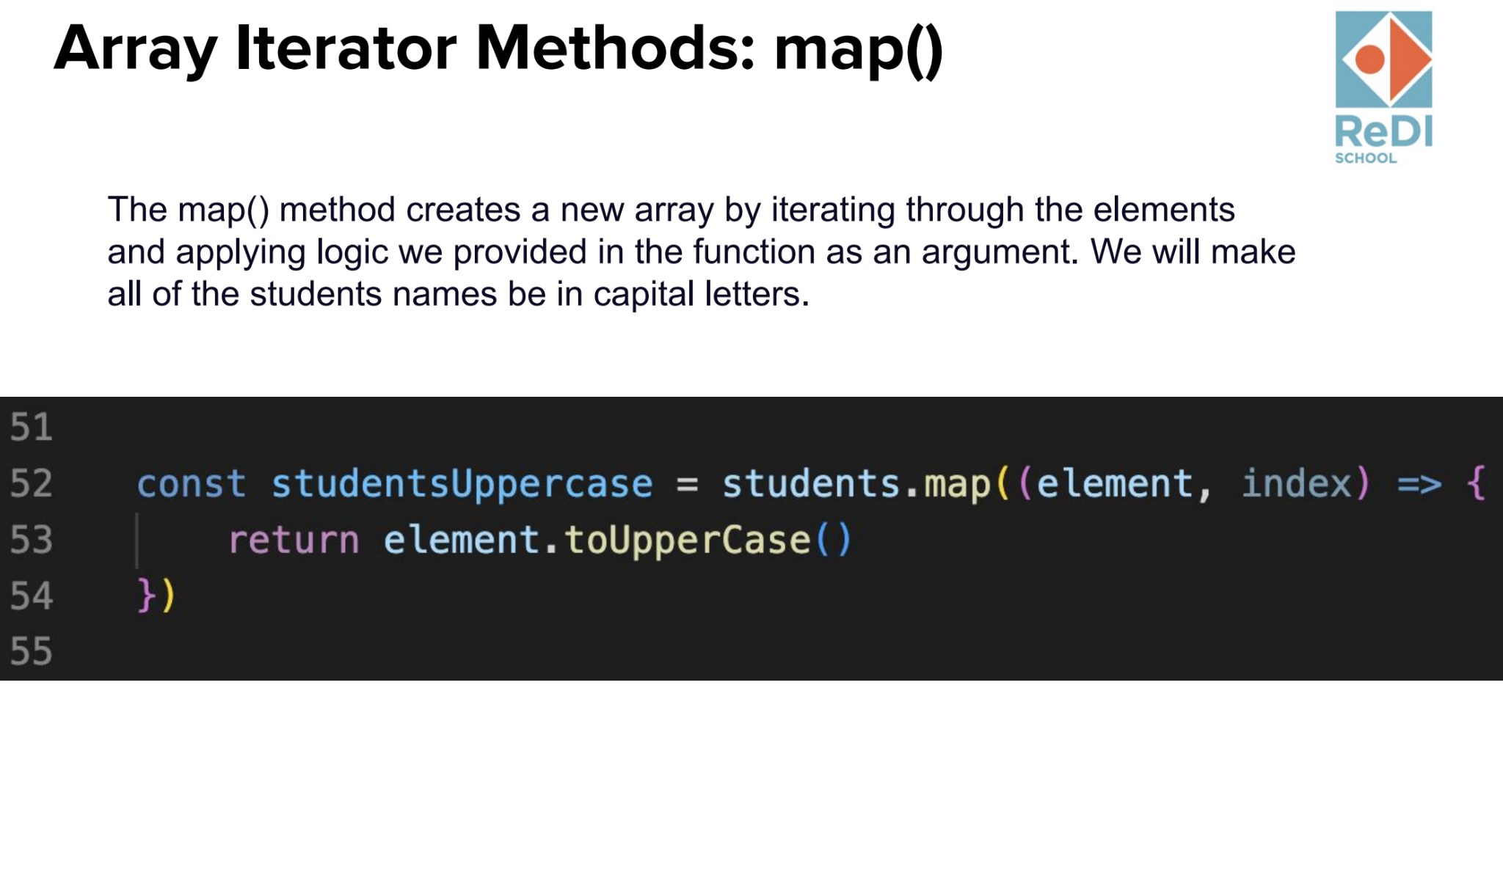
Recap

Slide 7
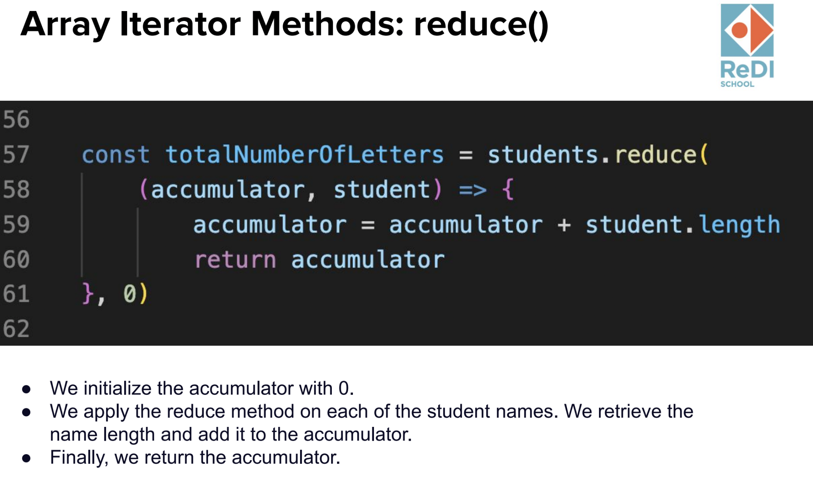
Recap

Slide 8
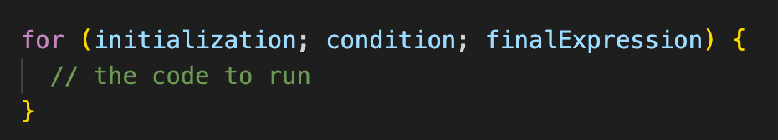
Recap - For loop
Loops are handy, if you want to run the same code over and over again, each time with a different value. Let’s take a look at the first loop type:
initialization - This expression runs before the execution of the first loop, and is usually used to create a counter.
condition - This expression is checked each time before the loop runs. If it evaluates to true, the statement or code in the loop is executed. If it evaluates to false, the loop stops. And if this expression is omitted, it automatically evaluates to true.
finalExpression - This expression is executed after each iteration of the loop. This is usually used to increment a counter, but can be used to decrement a counter instead.

Slide 9
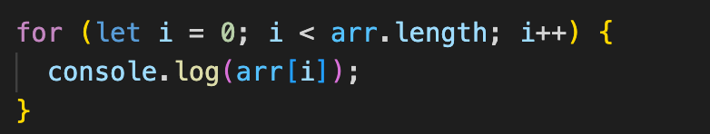
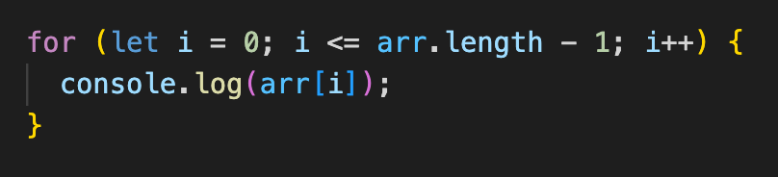
Recap - For loop over an array
There are two ways to fix this code: set condition to either i < arr.length or i <= arr.length - 1.

Slide 10
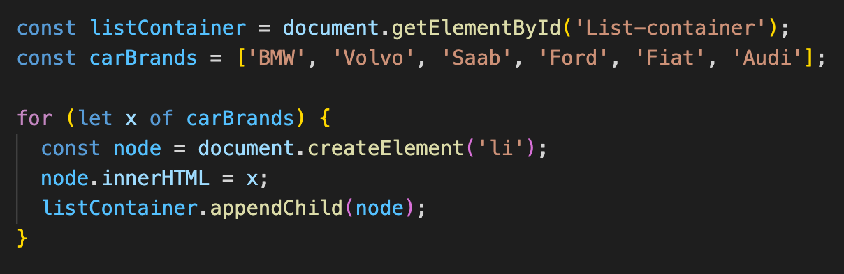
Recap - For-of loop
The JavaScript for-of statement loops through the values of an iterable object.
It lets you loop over iterable data structures such as Arrays, Strings, Maps, NodeLists, and more:

Slide 11
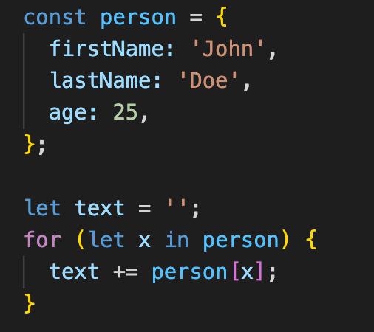
Recap - For-in loop
The JavaScript for in statement loops through the properties of an Object:
The for in loop iterates over a person object
Each iteration returns a key (x)
The key is used to access the value of the key
The value of the key is person[x]

Slide 12
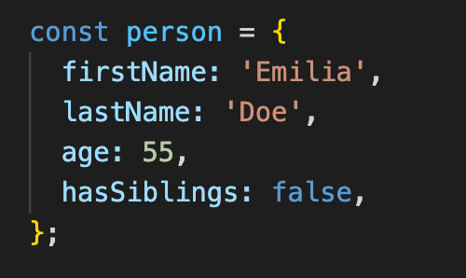
Objects
An object is a collection of properties, and this properties consist of a name (or key) and a value pair.
Objects in JavaScript, just as in many other programming languages, can be compared to objects in real life.
Compare it with a cup, for example. A cup is an object, with properties. A cup has a color, a design, weight, a material it is made of, etc. The same way, JavaScript objects can have properties, which define their characteristics.

Slide 13
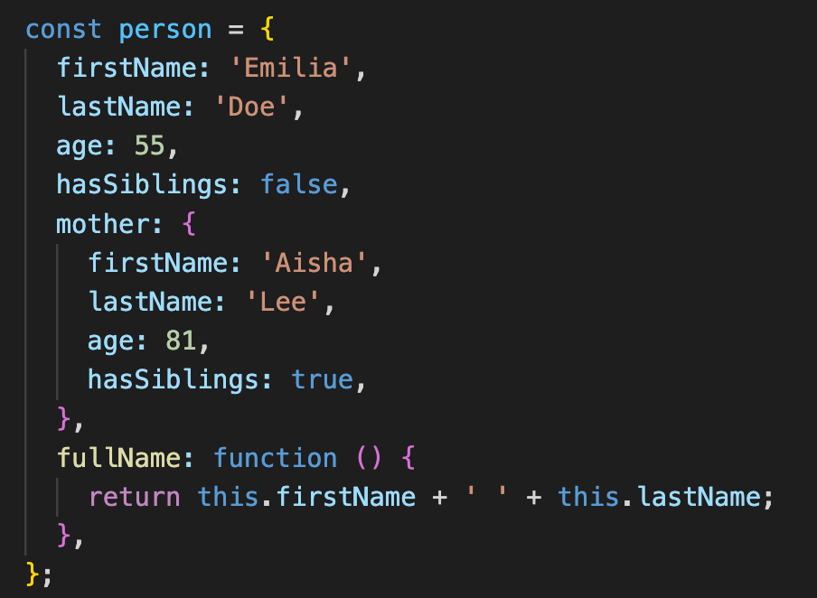
Object Properties
Object properties can be both primitive values, other objects, and functions.

Slide 14
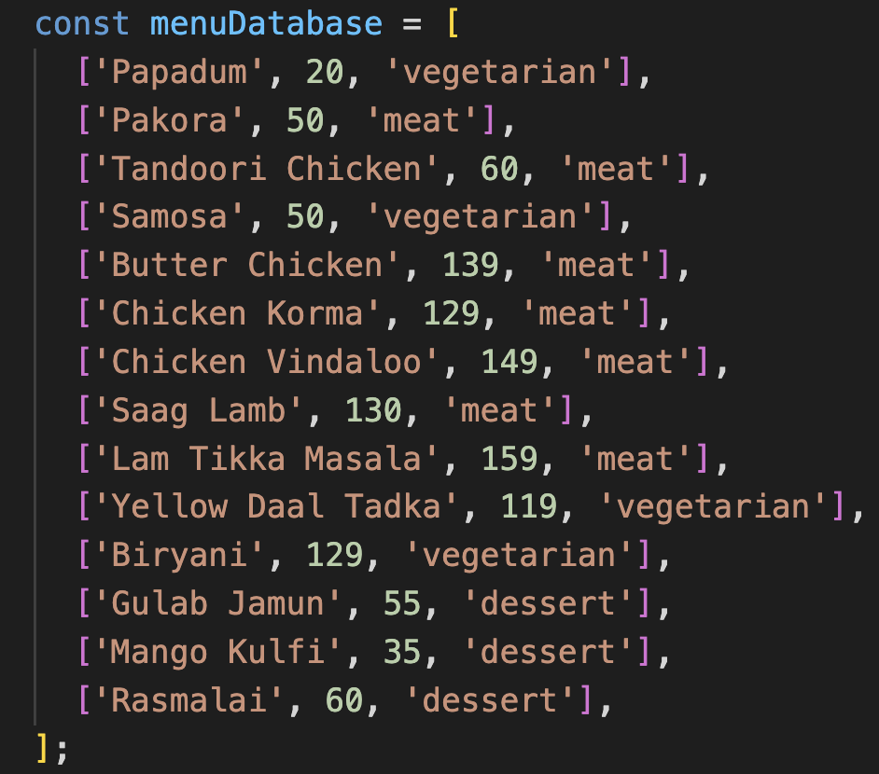
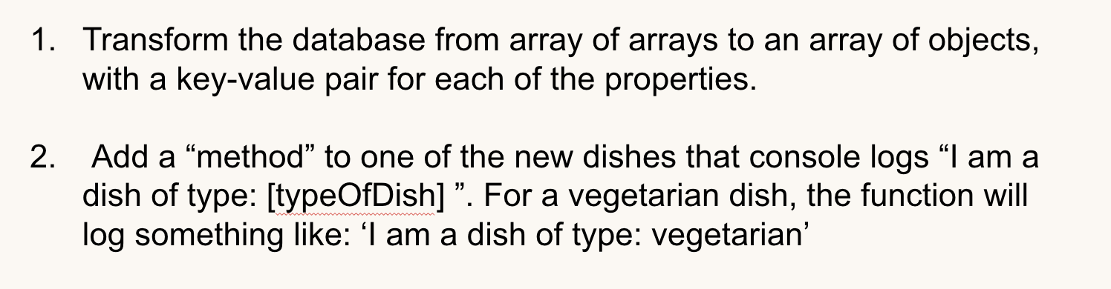
Object Methods
Whenever a property’s value is a function, the property is known as a method.

Slide 15
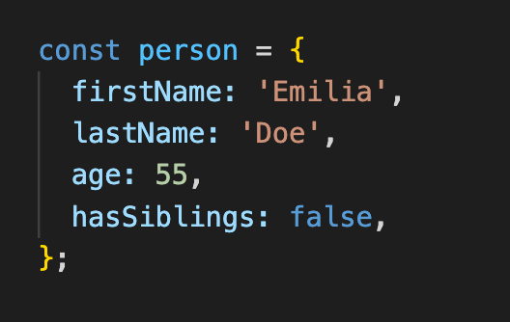
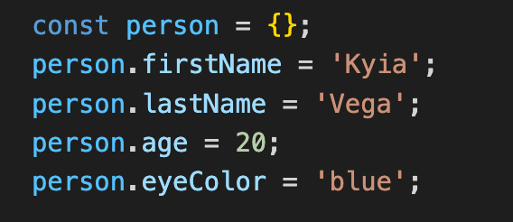
How to create an object?
There are different ways to create new objects, we are going to take a look at the 2 most common ways
Create a single object, using an object literal.

Slide 16
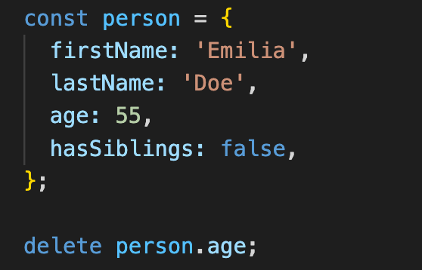
Deleting Properties

Slide 17
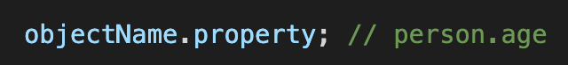
How to access an object property
The syntax for accessing the property of an object is:
OR
OR

Slide 18
Exercise
< 20 minutes >
Intro: Your family owns a restaurant and you want to create a website for it. In the next slide you can find a database of your family’s restaurant menu.
Transform the database from array of arrays to an array of objects, with a key-value pair for each of the properties.
Add a “method” to one of the new dishes that console logs “I am a dish of type: [typeOfDish] ”. For a vegetarian dish, the function will log something like: ‘I am a dish of type: vegetarian’
Notes:
Make a cup of tea
get water
from: tap || bottled || well
get tea
from: cupboard || supermarket
if loose tea, put tea in filter
get cup
from: cupboard || store
boil water
in: kettle || (pot && (stove || fire))
wait for water to cool slightly
<if white or green tea> until water is 80 degrees celsius
<if black tea> don’t wait (needs 100 degrees celsius)
put tea filter into cup
poor water into cup
wait
depending on the kind of tea: 1-10 min.
remove tea filter from cup
drink tea
Cook bowl of rice
get water
from: tap || bottled || well
get rice
from: cupboard || supermarket
<if rice cooker is available>
add rice and water into cooker
turn on cooker
<else>
get pot
from: cupboard || store
put rice into pot
add water
amount dependent on type of rice
boil rice
on: stove || fire
time: dependent on the type of rice
remove pot from warmth
wait
time: dependent on the type of rice and cooking method
get bowl
from: cupboard || store
poor rice into bowl
eat the rice
Access the internet from a computer
(prerequisite: functioning computer is available)
get computer
turn on computer
<if password is required> log into computer
turn on wifi
connect to wifi
<if password is required> type in wifi password
open prefered browser
<if browser has separate search bar>
type search string into search bar
<else>
type search string into address bar
press enter
feel the surfing
Start a car
(prerequisite: valid driver’s license)
get the car key
<if car doesn’t have automatic unlocking>
<if car has central lock> click open button on car key
<if car has manual lock> put key into car door and turn to unlock
open car door
sit down at the driver’s seat
close the car door
put on seat belt
<if car has a stick>
put car in first/reverse gear
step on the clutch and hold it down
<else>
put car in drive/reverse mode
<if car is NOT keyless>
put car key into keyhole
turn car key to start the engine
<else>
press turn-on button
<if car has a stick>
slowly lift the clutch AND slowly step on the speeder
<else>
slowly step on the speeder
start driving

Slide 19
Exercise
< 20 minutes >
Notes:
Make a cup of tea
get water
from: tap || bottled || well
get tea
from: cupboard || supermarket
if loose tea, put tea in filter
get cup
from: cupboard || store
boil water
in: kettle || (pot && (stove || fire))
wait for water to cool slightly
<if white or green tea> until water is 80 degrees celsius
<if black tea> don’t wait (needs 100 degrees celsius)
put tea filter into cup
poor water into cup
wait
depending on the kind of tea: 1-10 min.
remove tea filter from cup
drink tea
Cook bowl of rice
get water
from: tap || bottled || well
get rice
from: cupboard || supermarket
<if rice cooker is available>
add rice and water into cooker
turn on cooker
<else>
get pot
from: cupboard || store
put rice into pot
add water
amount dependent on type of rice
boil rice
on: stove || fire
time: dependent on the type of rice
remove pot from warmth
wait
time: dependent on the type of rice and cooking method
get bowl
from: cupboard || store
poor rice into bowl
eat the rice
Access the internet from a computer
(prerequisite: functioning computer is available)
get computer
turn on computer
<if password is required> log into computer
turn on wifi
connect to wifi
<if password is required> type in wifi password
open prefered browser
<if browser has separate search bar>
type search string into search bar
<else>
type search string into address bar
press enter
feel the surfing
Start a car
(prerequisite: valid driver’s license)
get the car key
<if car doesn’t have automatic unlocking>
<if car has central lock> click open button on car key
<if car has manual lock> put key into car door and turn to unlock
open car door
sit down at the driver’s seat
close the car door
put on seat belt
<if car has a stick>
put car in first/reverse gear
step on the clutch and hold it down
<else>
put car in drive/reverse mode
<if car is NOT keyless>
put car key into keyhole
turn car key to start the engine
<else>
press turn-on button
<if car has a stick>
slowly lift the clutch AND slowly step on the speeder
<else>
slowly step on the speeder
start driving

Slide 20

Break
10-15 minutes to get up and relax

Slide 21
Let’s talk about our final project!

Slide 22

Final Project

Slide 23

Final Project

Slide 24

Final Project

Slide 25

Final Project

Slide 26
Final Project Purpose
Create a portfolio-worthy project with all the tools and knowledge shared throughout the course so that you start accumulating coding experience for your front-end career.

Slide 27
Final Project Learning goals
Reinforce and practice all the knowledge shared in the course
Use all the concepts you have been through and put all of them together to create something beautiful
Have your first strong project to show to your future employees
Get support from your teachers and assistants to help you and guide you through the process so you can successfully create a project you are proud of
Support and get support from your colleagues that have been through the same curriculum and are probably your very first colleagues.

Slide 28
Final Project core concepts
HTML elements
CSS rules and specificity
Variables
DOM Manipulation
Event Listeners
Functions
Control flow
Arrays
Objects
Loops

Slide 29
Final Project core concepts
HTML elements
CSS rules and specificity
Variables
DOM Manipulation
Event Listeners
Functions
Control flow
Arrays
Objects
Loops

Slide 30

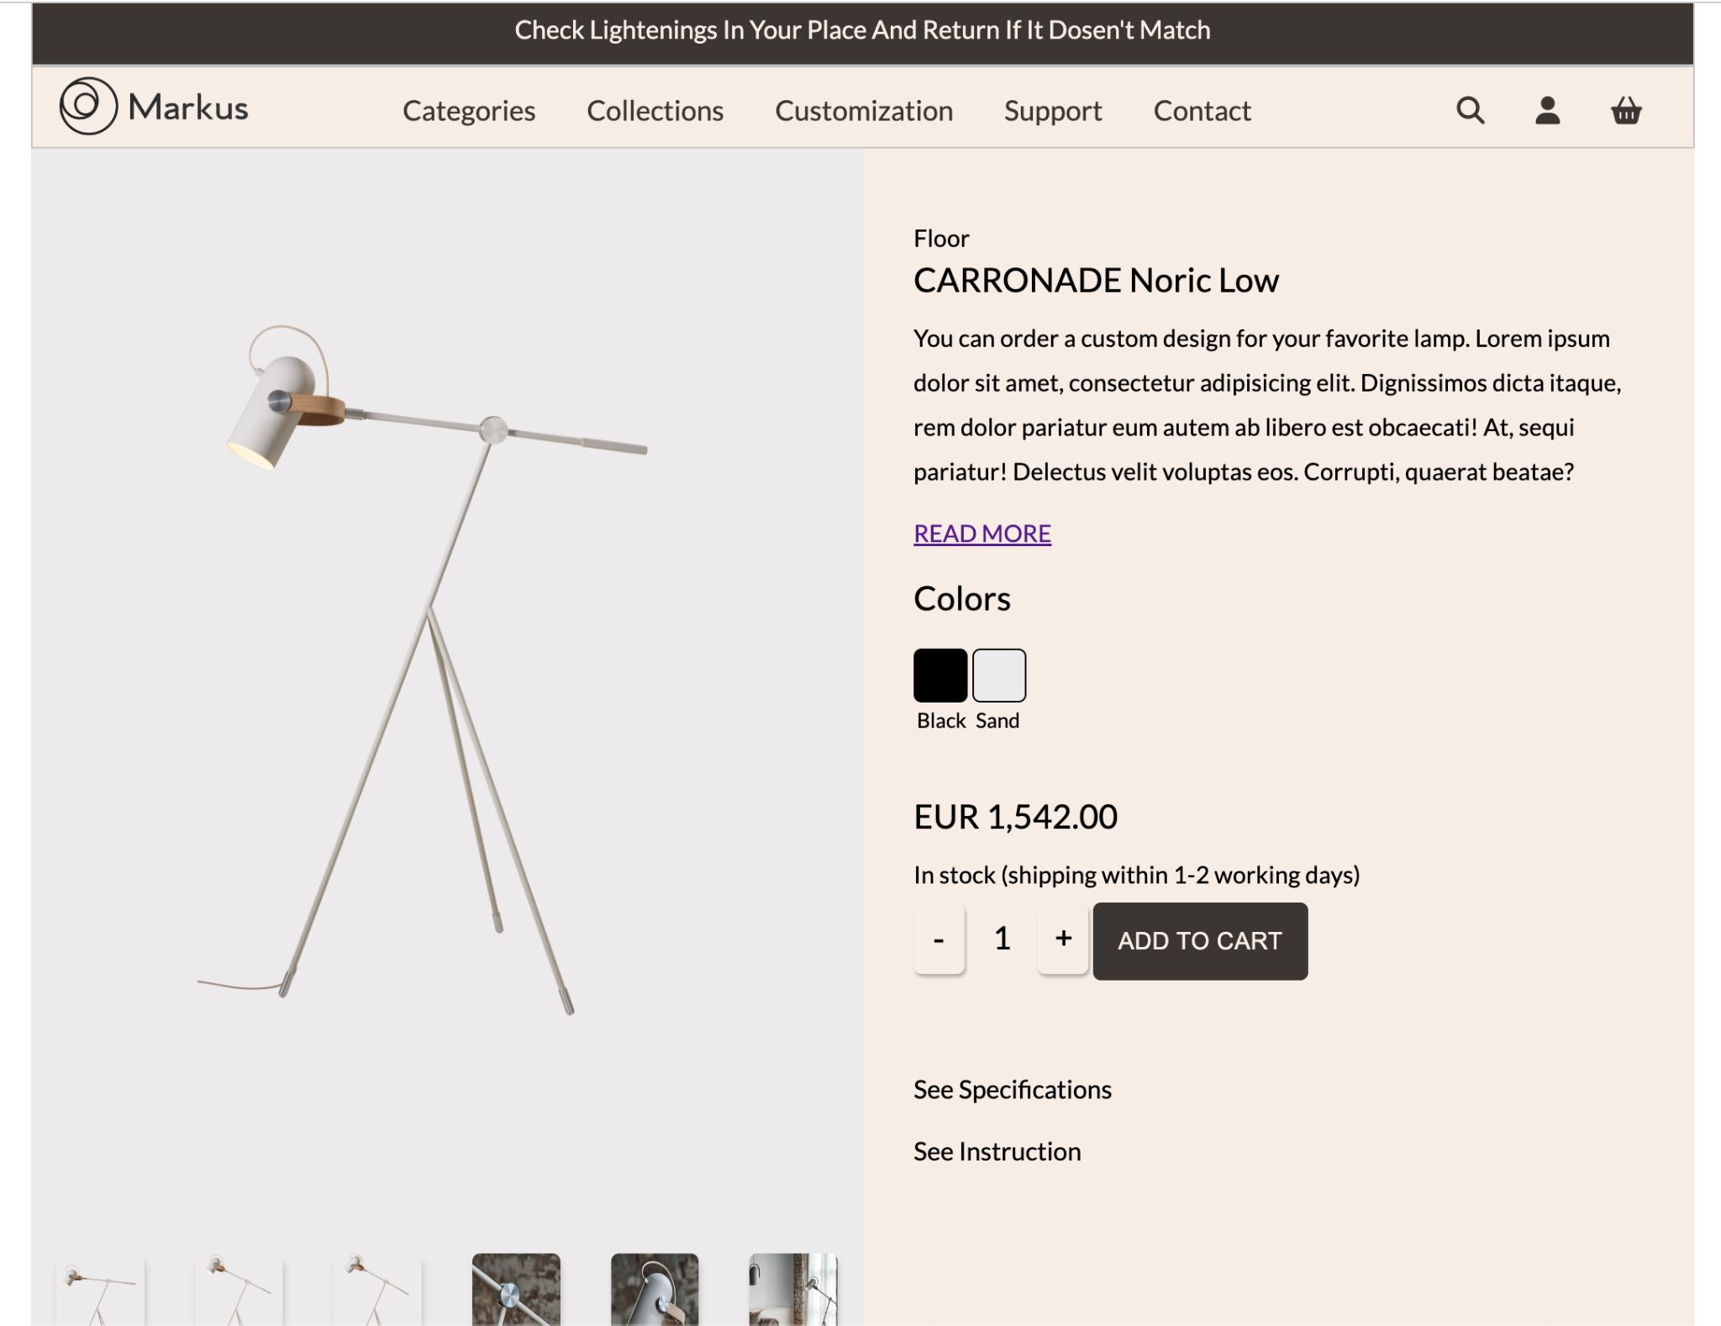
Outcome: Final Project

Slide 31
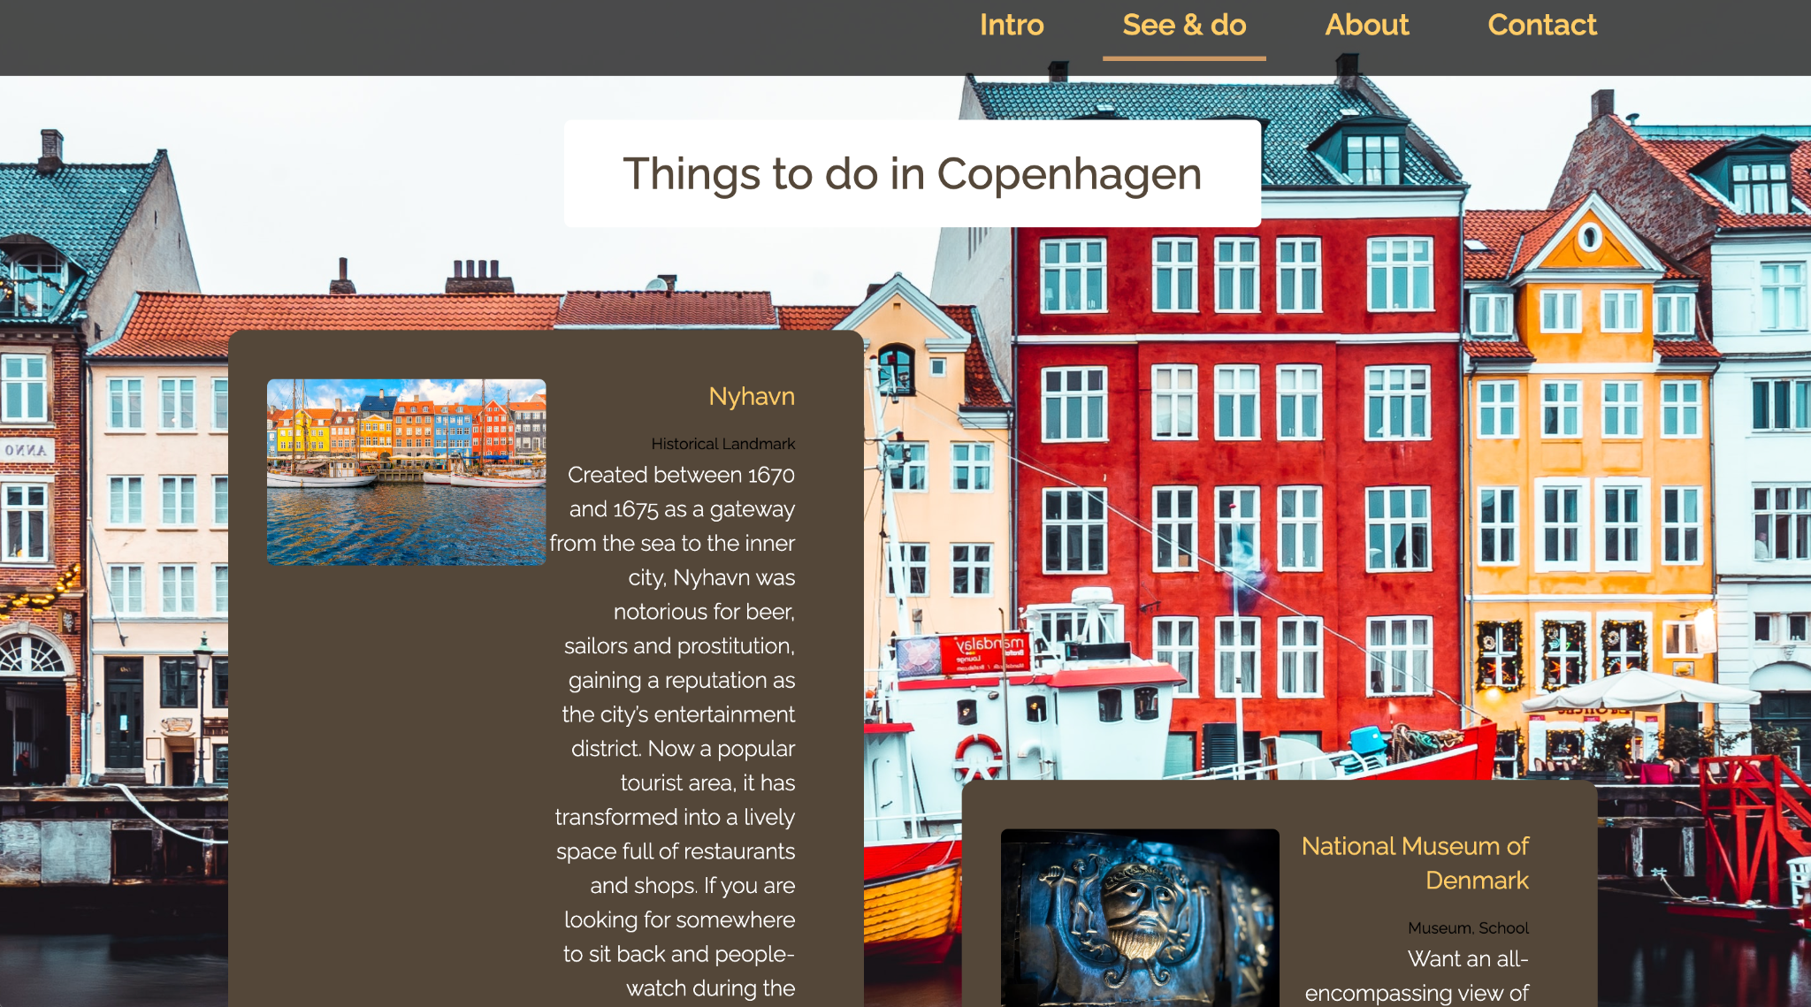
Outcome: Final Project

Slide 32
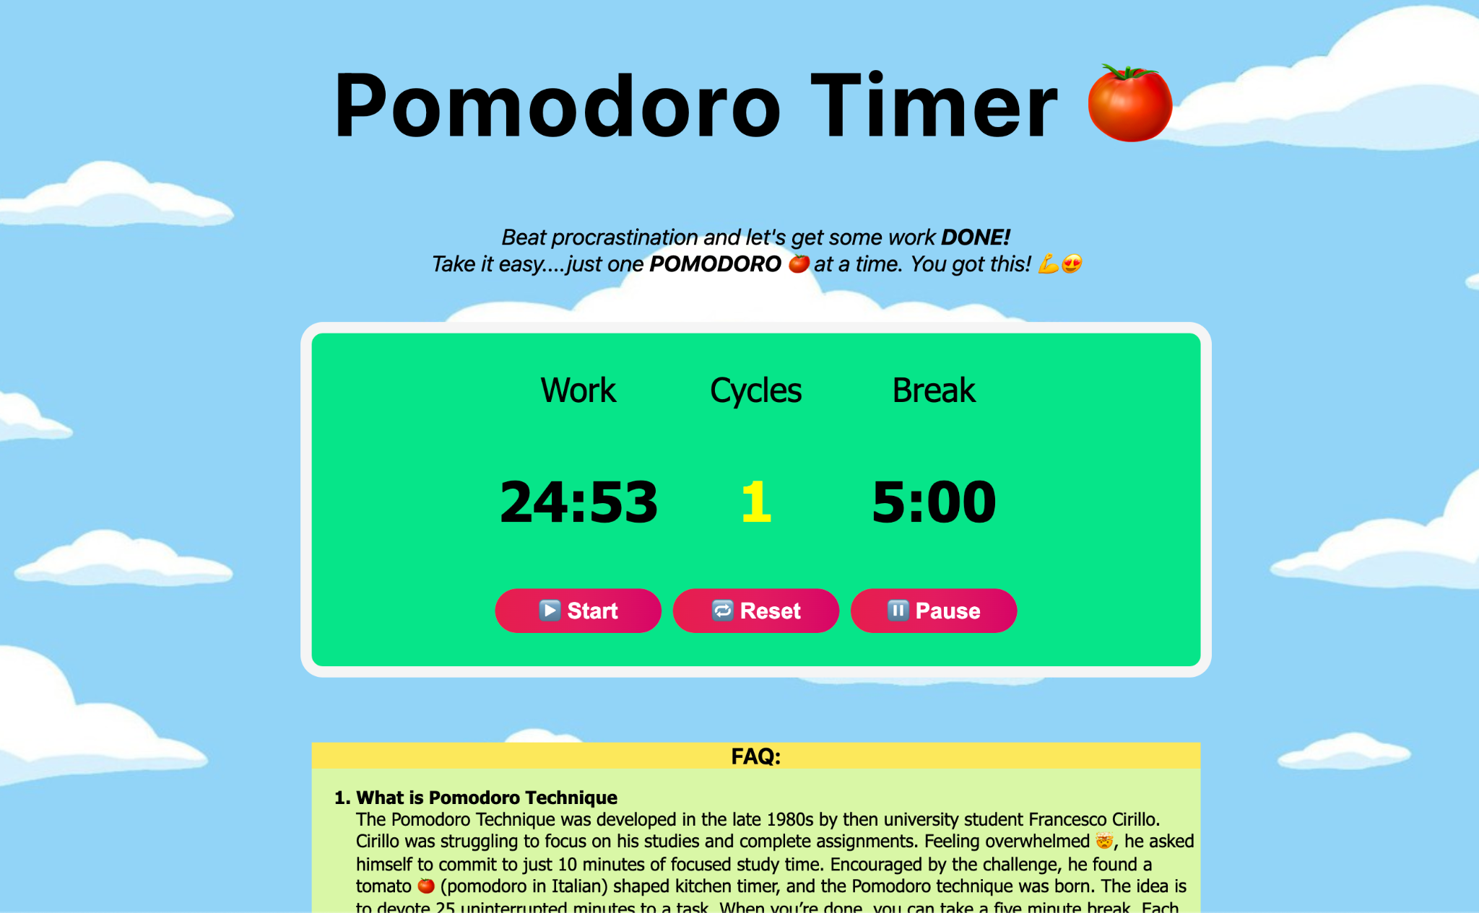
Outcome: Final Project

Slide 33
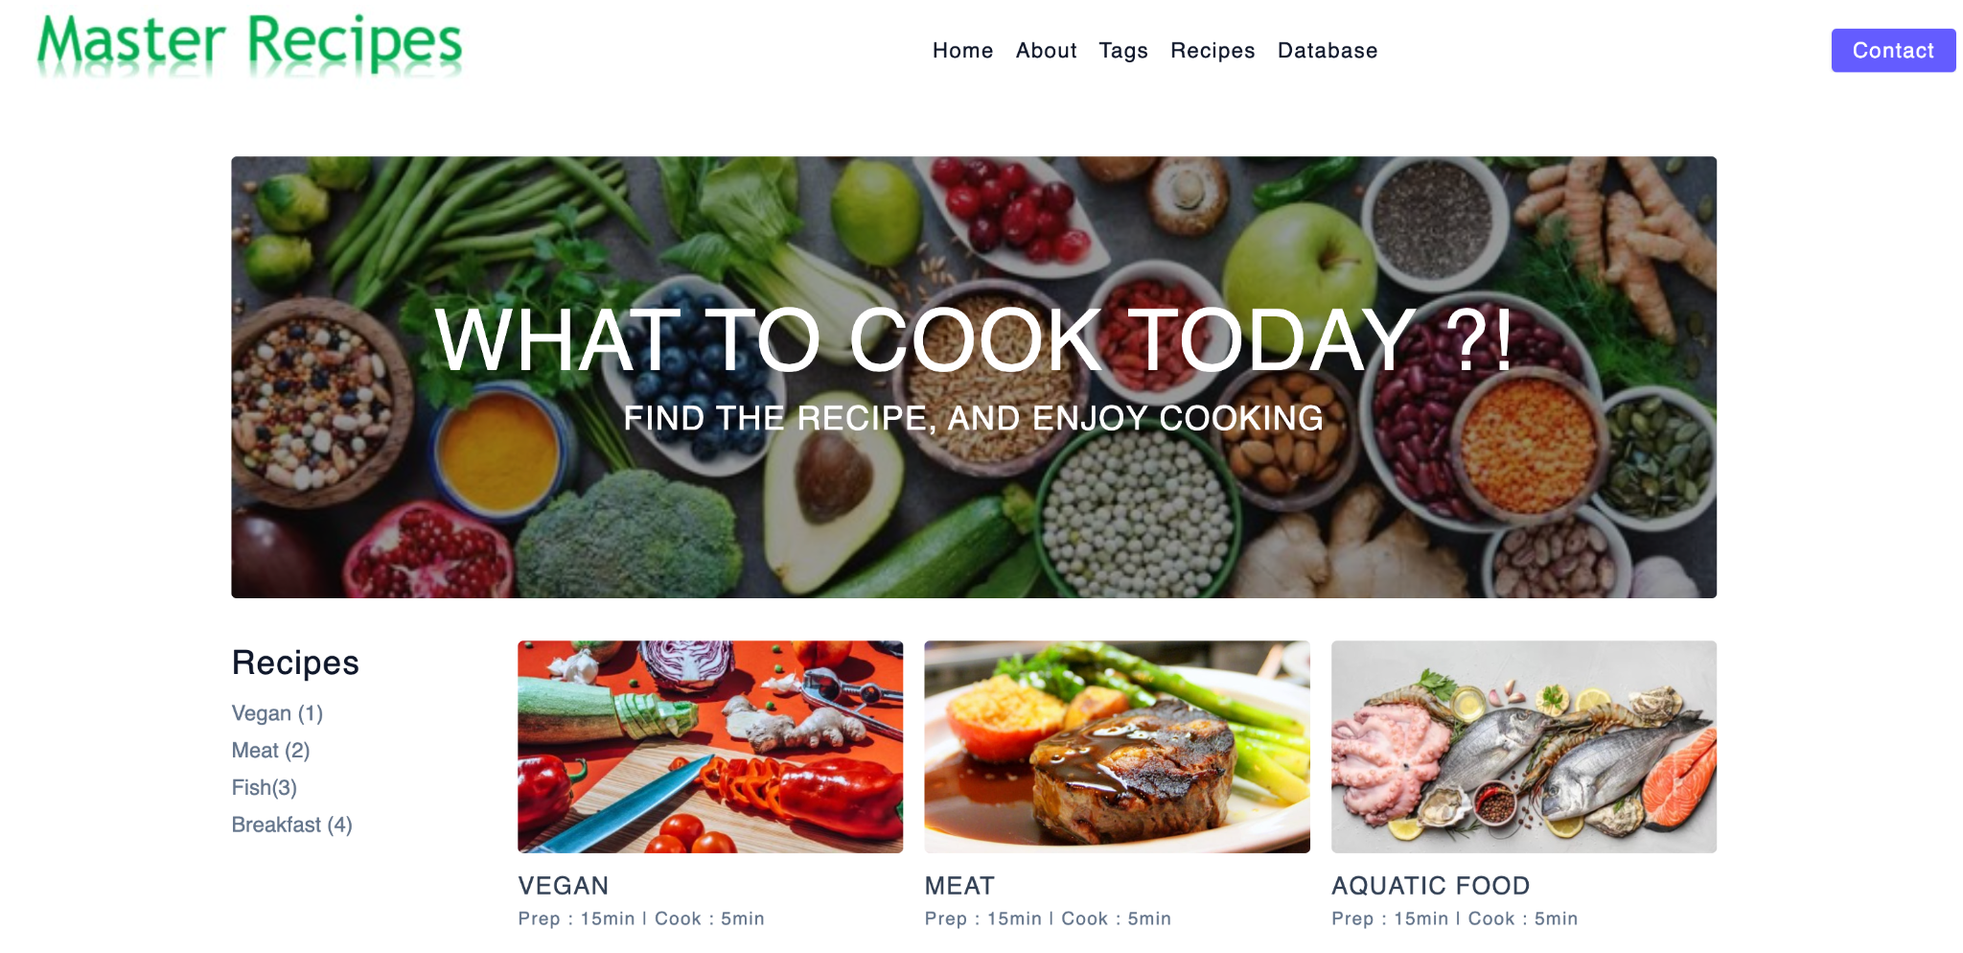
Outcome: Final Project

Slide 34

Outcome: Final Project

Slide 35
Ideation for final project
In groups or alone

Slide 36
Homework
Do:
Attached to these slides, will be sharing an array that represents the database of your restaurant’s website. On this database we want you to do the following tasks:
After some months of your restaurant being open, you realised that the last element in the menu hasn’t been sold in the last 4 months so you decide to remove it from the menu, use an array method to remove the last element of an array and save it in a variable called: removedMenuItem.
Due to inflation you have gone through your finances and you realised that you need to increase all the menu prices by 10%. To do this we want to create a new array (called increasedMenuDatabase) containing all the menu items with the mentioned price increase. Hint: Use the ‘map’ method.
A customer asks you about how many vegetarian dishes you have in the menu, for this you might want to filter the menu and get the amount of items filtered by the type: ‘vegetarian’. Call this variable: amountVegetariantDishes.
There’s a table that ordered all the dishes containing meat (1x time each dish), and they are ready to pay. Use the reduce method to get the total value of all the dishes that contain meat so that the customer can pay you. Call this variable: totalAmountMeatDishes.

Slide 37
Homework
Do:
Attached to these slides, will be sharing an array that represents the database of your restaurant’s website. On this database we want you to do the following tasks:
3. A customer asks you about how many vegetarian dishes you have in the menu, for this you might want to filter the menu and get the amount of items filtered by the type: ‘vegetarian’. Call this variable: amountVegetariantDishes.
4. There’s a table that ordered all the dishes containing meat (1x time each dish), and they are ready to pay. Use the reduce method to get the total value of all the dishes that contain meat so that the customer can pay you. Call this variable: totalAmountMeatDishes.

Slide 38
Homework
Do:
Now we need to go back and practice some DOM manipulation with JavaScript.
The idea is to use the powers of loops and arrays to build our website from a database. The pseudocode for this task would look something like:
Only write a <ul> element in your HTML document with an id
Get the <ul> element using getElementById
Use any type of the for loops you think might work to loop through the database.
In each iteration create a <li> element
Create an <img> element for the product image, and 3 <p> elements for product name, price and colors (using createElement).
Attach these 4 elements to the <li> created before
Attach the <li> to the <ul> element

